Slide 1
E-retail factors for customer activation and retention
Submitted by – Amruta Shah

Slide 2
Information
Customer satisfaction has emerged as one of the most important factors that guarantee the success of online store.
It has been posited as a key stimulant of purchase, repurchase intentions and customer loyalty.
A comprehensive review of the literature, theories and models have been carried out to propose the models for customer activation and customer retention.
Five major factors that contributed to the success of an e-commerce store have been identified as: service quality, system quality, information quality, trust and net benefit.

Slide 3
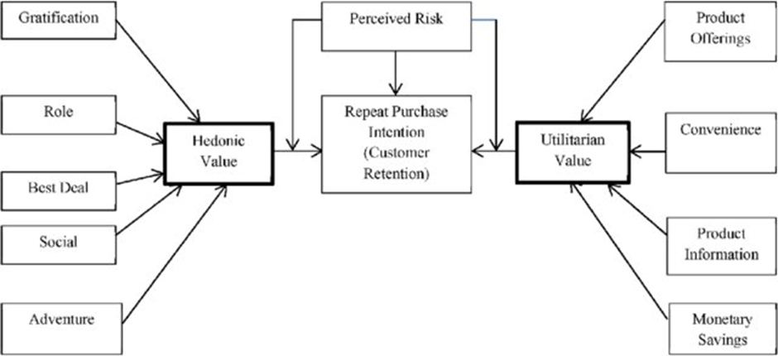
Problem Statement: -
To find out the e-retail success factors, which are very much critical for customer satisfaction & customer retention.

Slide 4
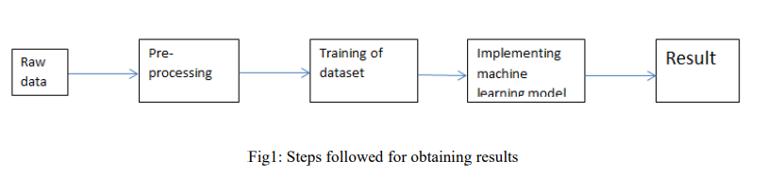
Methodology:-
The steps followed in this work, right from the dataset preparation to obtaining results are represented in Fig.

Slide 5
EDA (Exploratory Data Analysis):-
Import libraries: -
Import pandas as pd # for data manipulation
Import numpy as np # for mathematical calculations
Import seaborn as sns # for data visualization
Import matplotlib.pyplot as plt #for graphical analysis
%matplotlib inline
Import warnings # to ignore any warnings

Slide 6
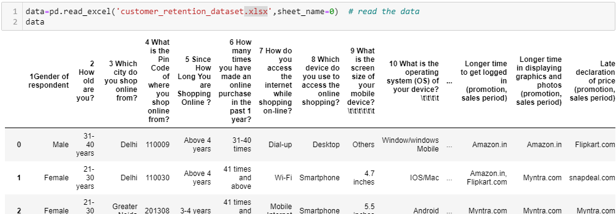
Load Dataset

Slide 7
Observations
There are 71 columns and 269 rows in the this dataset
There are no null values are present in this dataset.
We have categorical data type(object type)
Need to use pre-processing methods to convert categorical data to numerical.
Skewness and Outliers are present.
We can see that from column 47 to column 71 all the columns are having multiple comma separated values in each row.
There is no Target column present in this dataset.

Slide 8
Data Visualization
We now have a basic idea about the data. We need to extend that with some visualizations. We are going to look at three types of plots:
Univariate plots to better understand each variable.
Bivariate plots to find relationship between two variables,
Multivariate plots to better understand the relationships between variables.

Slide 9
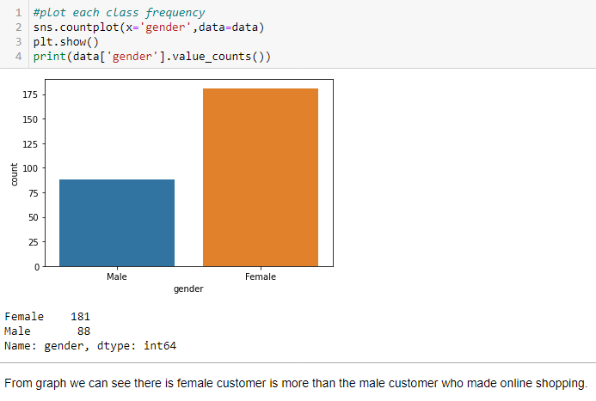
Univariate Plots:-

Slide 10
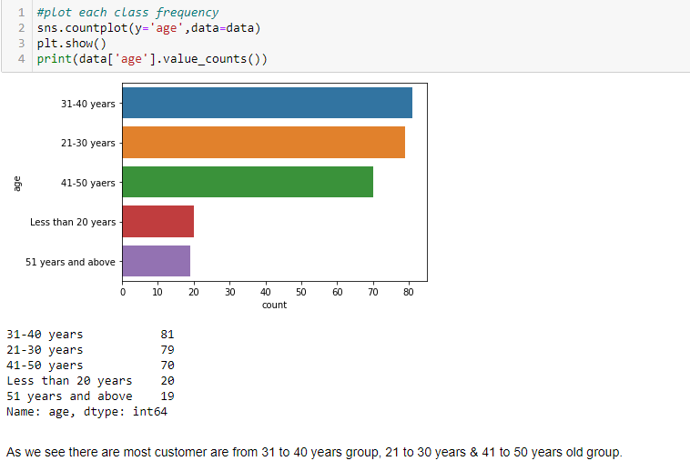

Slide 11
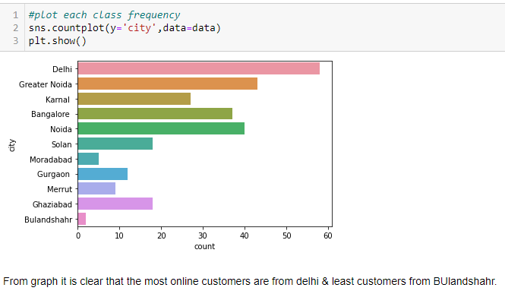

Slide 12
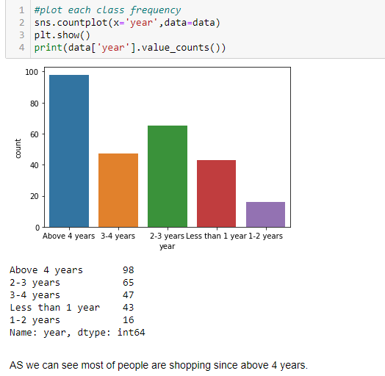

Slide 13
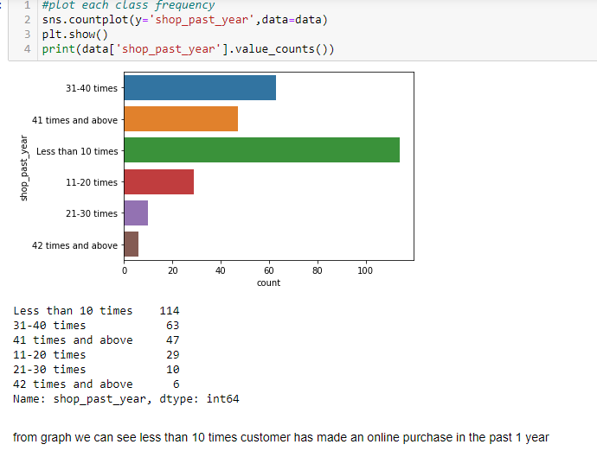

Slide 14
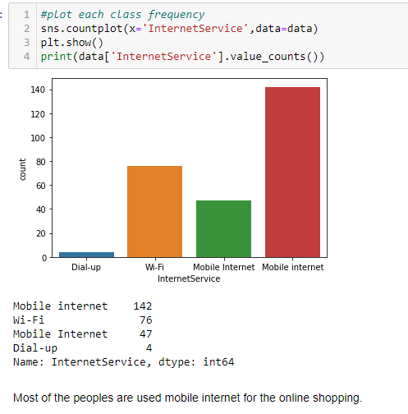

Slide 15
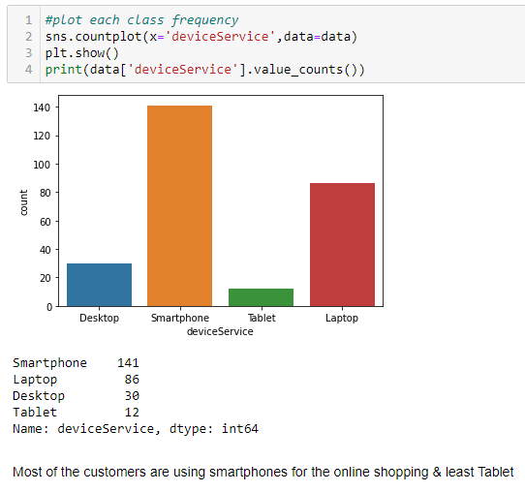

Slide 16
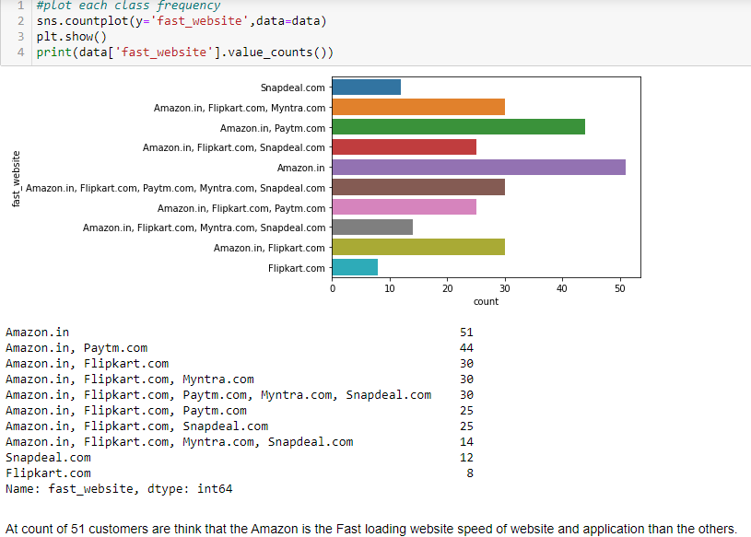

Slide 17
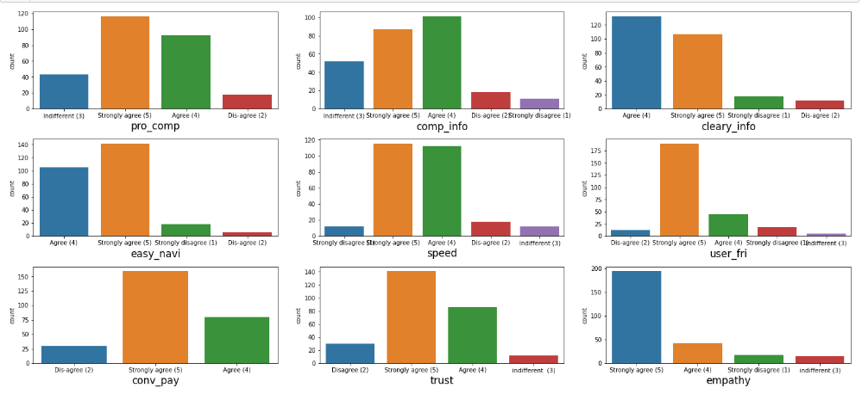
Uni-variate analysis for ordinal variables

Slide 18
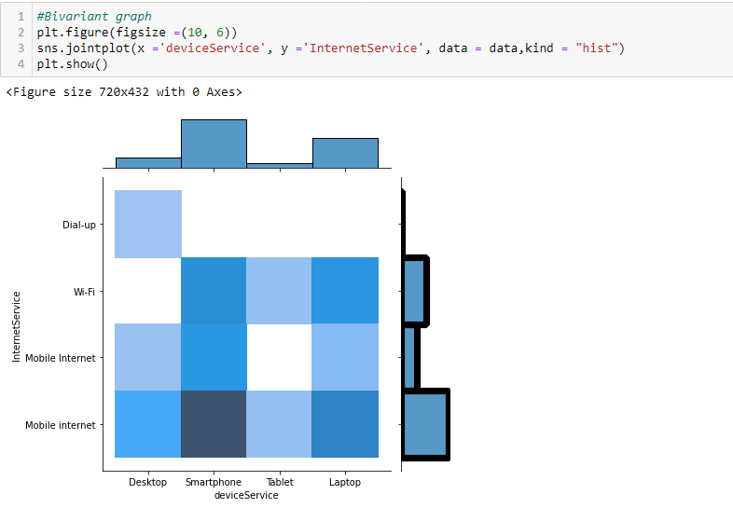
Bivariate Plot
From graph we can see most
of the peoples are used mobile
internet on smartphone for online shopping

Slide 19
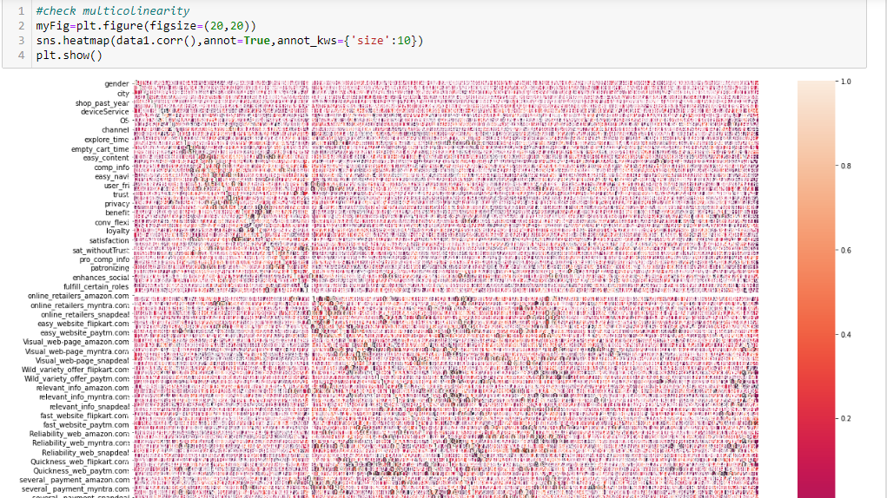
Multivariate Plot

Slide 20
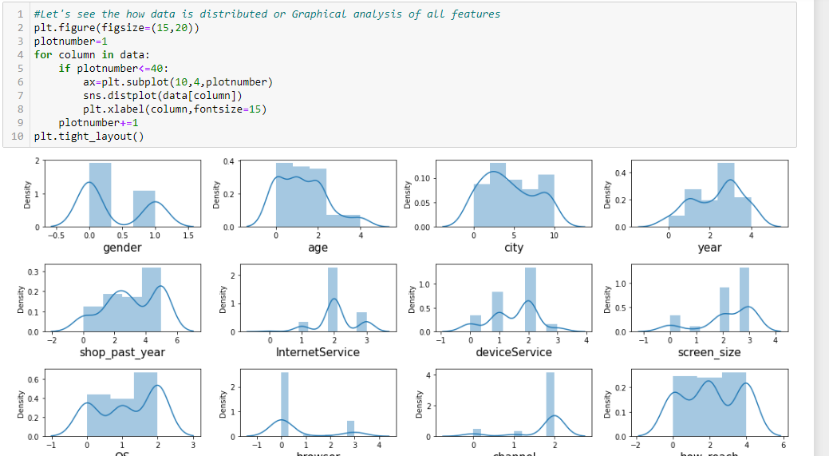
Data Pre-processing:-

Slide 21
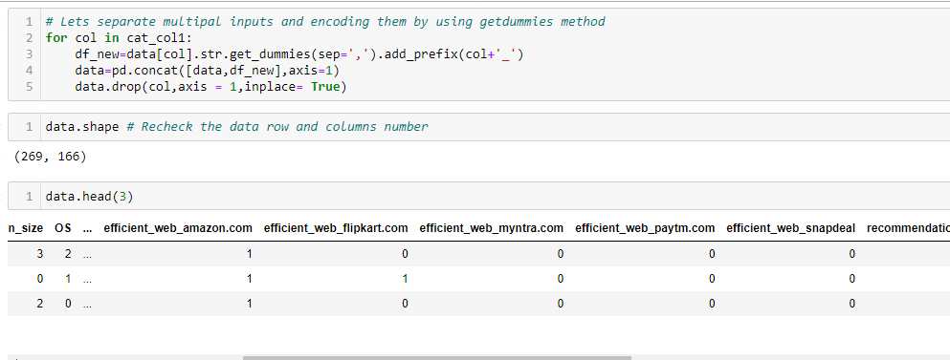
Separating data & Encoding :-

Slide 22
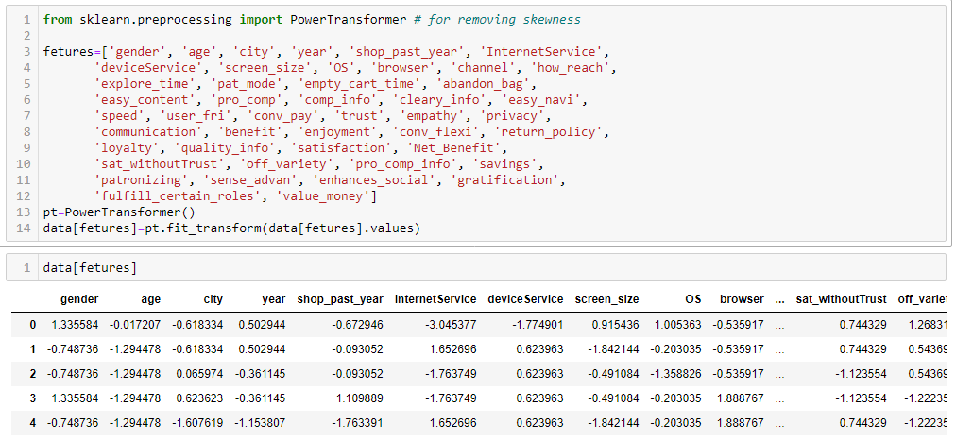
Removing skewness after encoding data

Slide 23
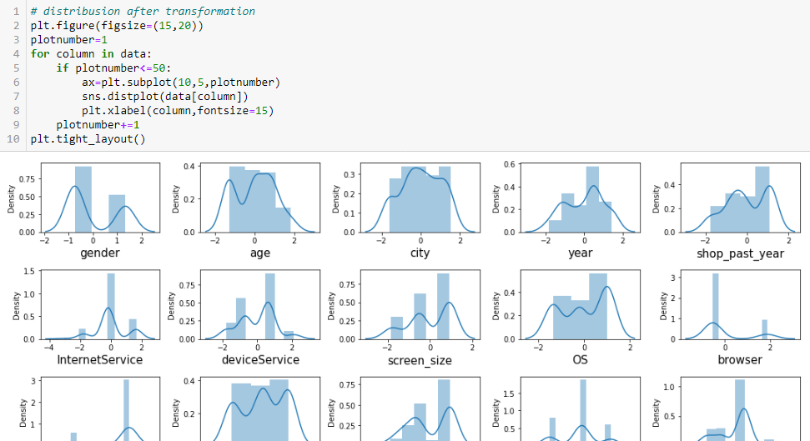
Distribution after removing skewness

Slide 24
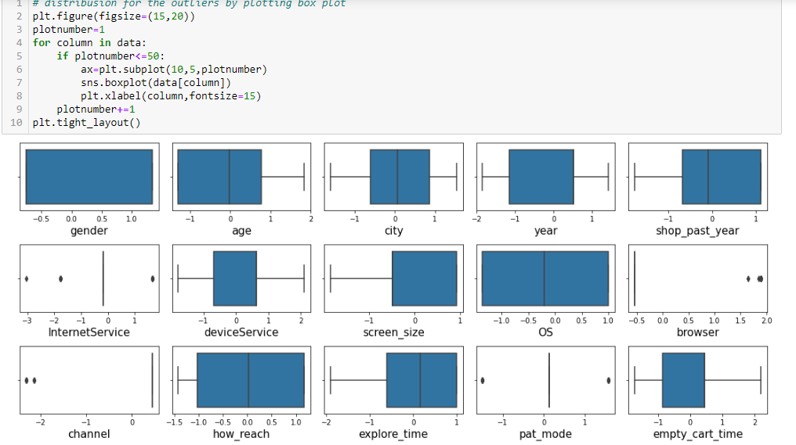
Distribution to see outliers

Slide 25
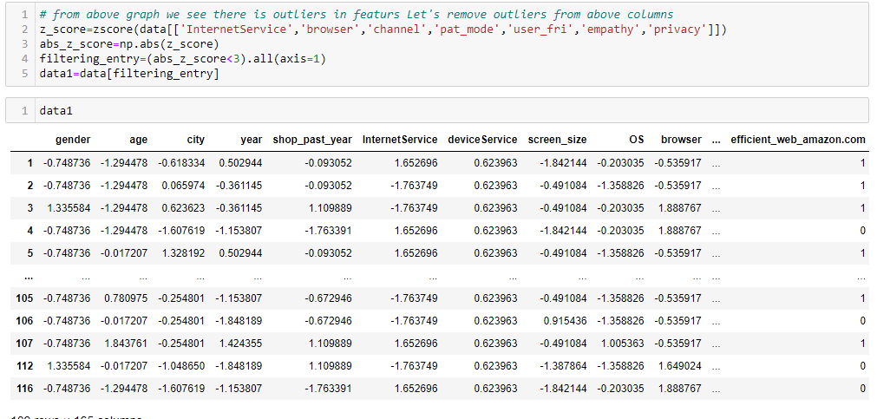
ZScore to remove outliers

Slide 26
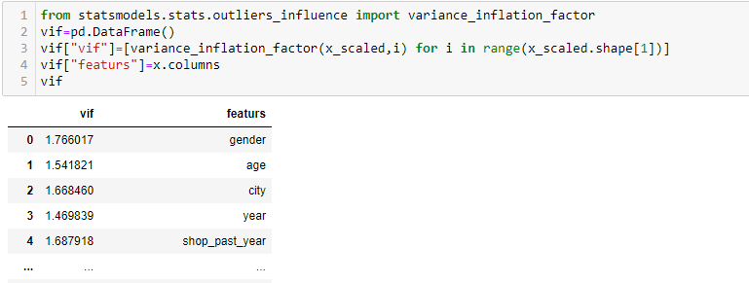
Multicollinearity by VIF

Slide 27
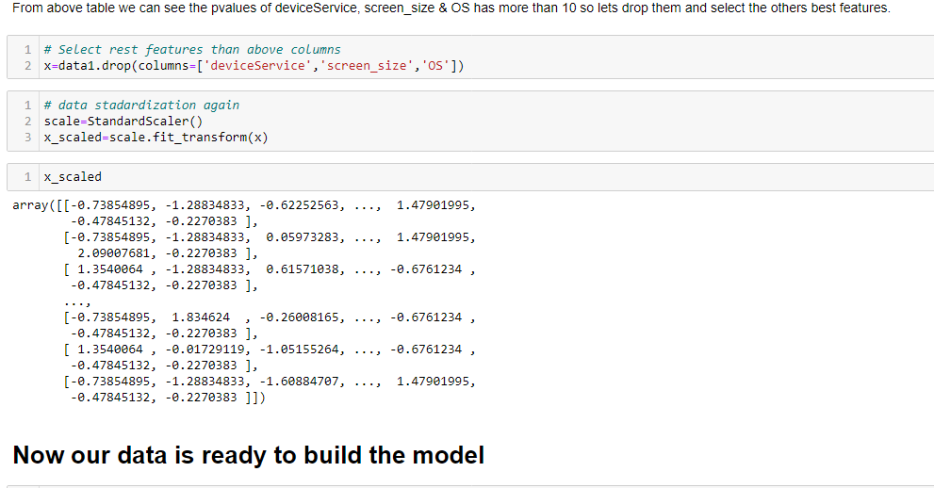

Slide 28
Conclusion and Future Scope: - In this paper, basics of machine learning and the associated data mining, data processing and modelling algorithms have been described, followed by their application for the task. when we compare all the variables of the data set, we find that customers who has e commerce sites which has short loading time, great deals, fast delivery time, trust, privacy and short loading time products etc. are the most important factors.

